Slide 1
Computer Architecture
Group two

Slide 2
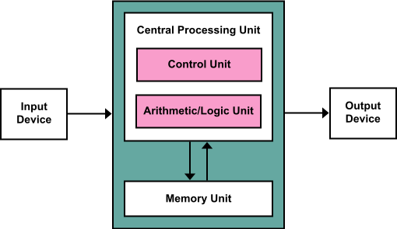
Von Neumann Architecture
CPU: ALU and control unit
Register: general-purpose and special-purpose
Bus
Main memory
Mass storage
Peripheral device: I/O
Von Neumann bottleneck

Slide 3
Havard Architecture
Separate storage and signal pathways for instructions and data.
Performance

Slide 4
Pipelining
Throughput vs. execution speed
Overlap: prefetching while executing
Instruction pipelining
Graphics pipelining
Software pipelining
HTTP pipelining

Slide 5
Multiprocessor Machine
Parallel processing
MIMD: multiple-instruction stream, multiple-data stream
SIMD: single-instruction stream, multiple-data stream

Slide 6
methods of performing input/output (I/O)
Memory-mapped I/O (MMIO)
port-mapped I/O (PMIO) or called isolated I/O
Port-mapped I/O often uses a special class of CPU instructions designed specifically for performing I/O, such as the in and out instructions
I/O devices have a separate address space from general memory, either accomplished by an extra "I/O" pin on the CPU's physical interface, or an entire bus dedicated to I/O.
for example,the x86 platform

Slide 7
via high-level language
int* ptr;
...some code...
*ptr = 0;
result in writing to a hardware input-output port if ptr happens to store the address to which that port is mapped. Usually they are called "embedded platforms".

Slide 8
device driver
A driver provides a software interface to hardware devices, enabling operating systems and other computer programs to access hardware functions without needing to know precise details of the hardware being used.

Slide 9
Reference
Computer science: an overview by J.Glenn Brookshear
Wikipedia

Slide 10
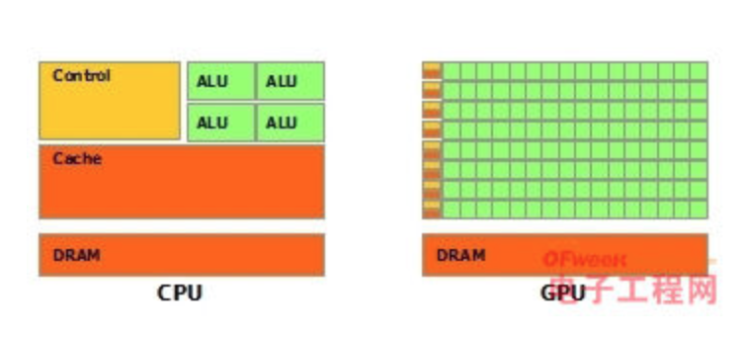
CPU GPU and TPU
Clock Speed: CPU > GPU
Cache, Local memory: CPU > GPU
Cores / Threads: GPU > CPU
Registers: GPU>CPU
CPU: A professor
GPU: Many element school students

Slide 11
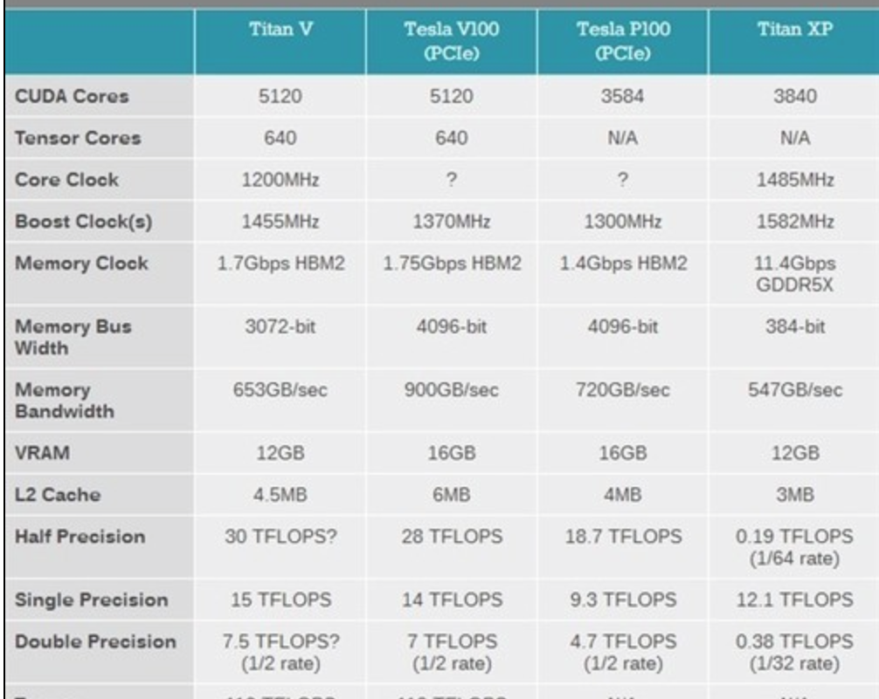
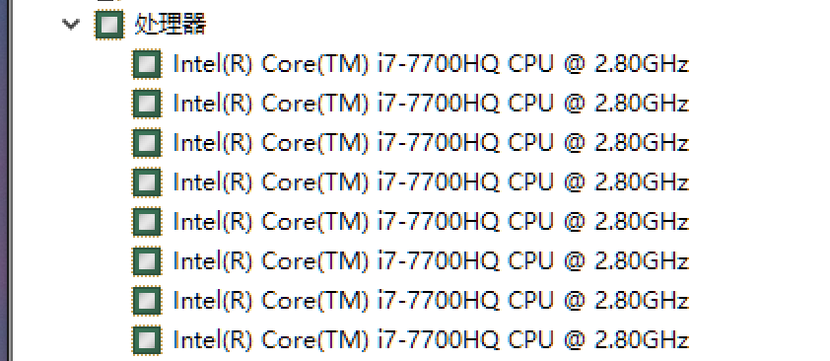


Slide 12
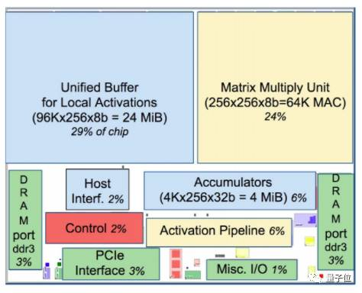
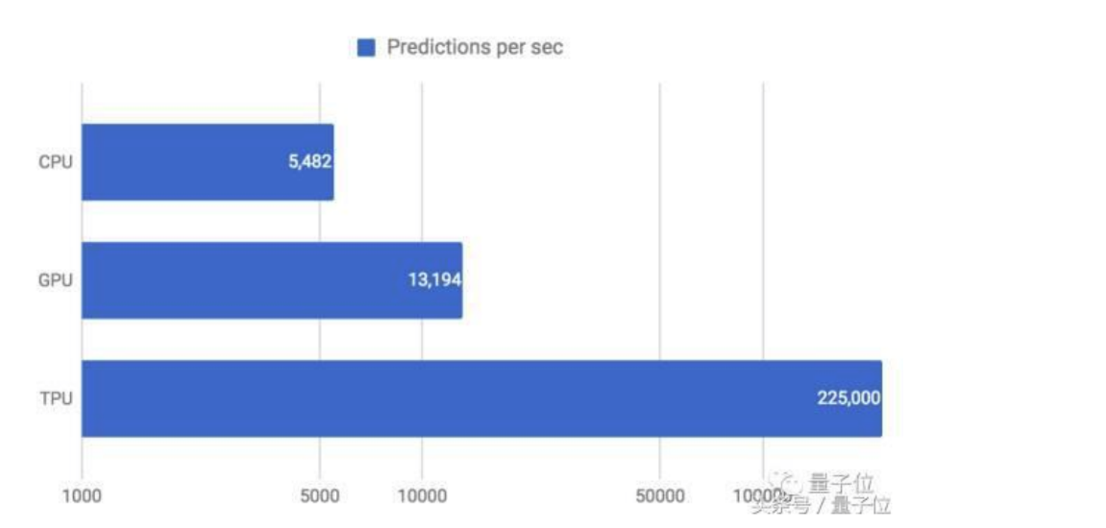
TPU
8 bits
Specified for matrix multiplication
Specification:
Only deal with certain task
For great performance.

Slide 13
assembler
File
Read by line
//
Judge:
A : dest = compute ;jump
Cut into 3 parts
C: @
A number ; Crate/Load
L: ()
Record the position

Slide 14
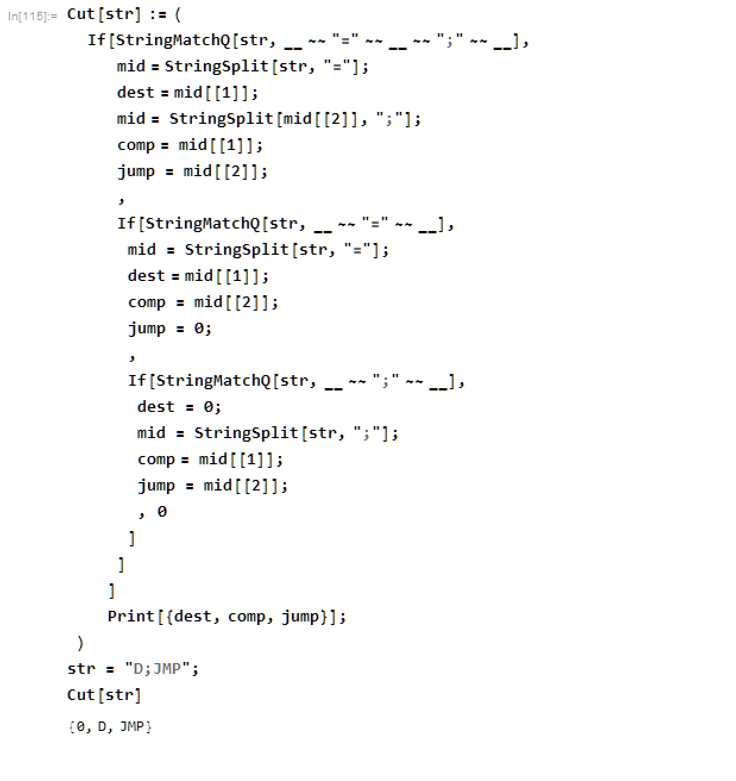
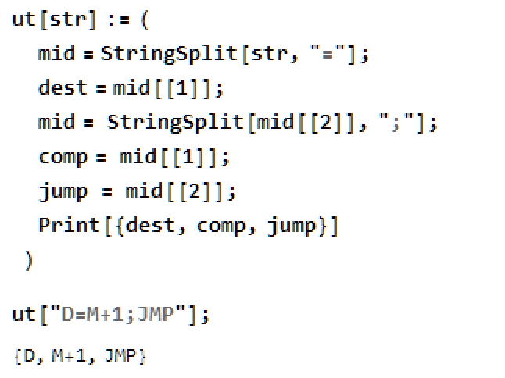
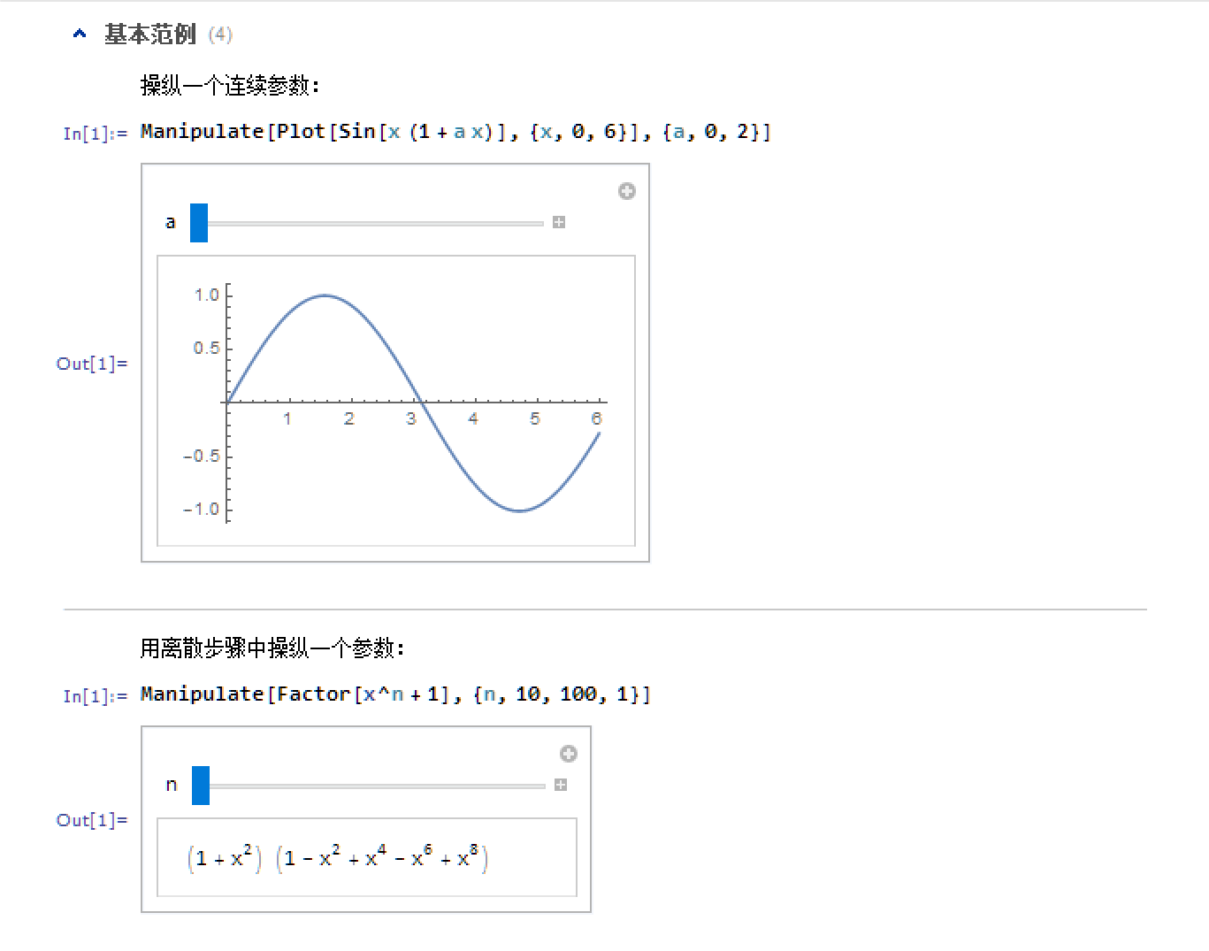
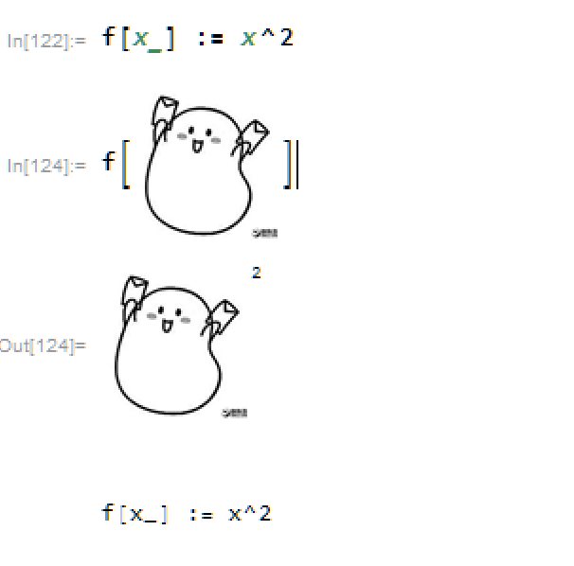
Benefit of mathmatica
flexible
Easy to learn,
try
and test.

Slide 15
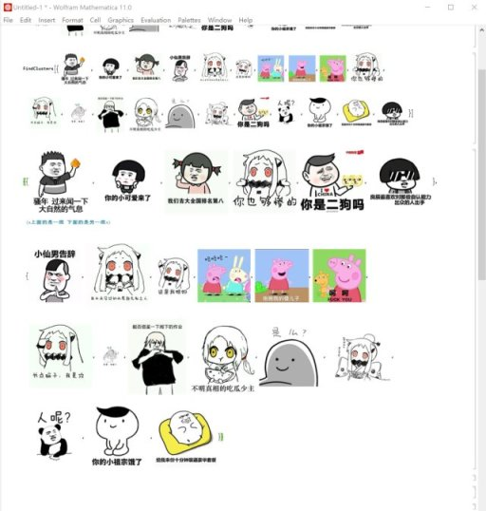
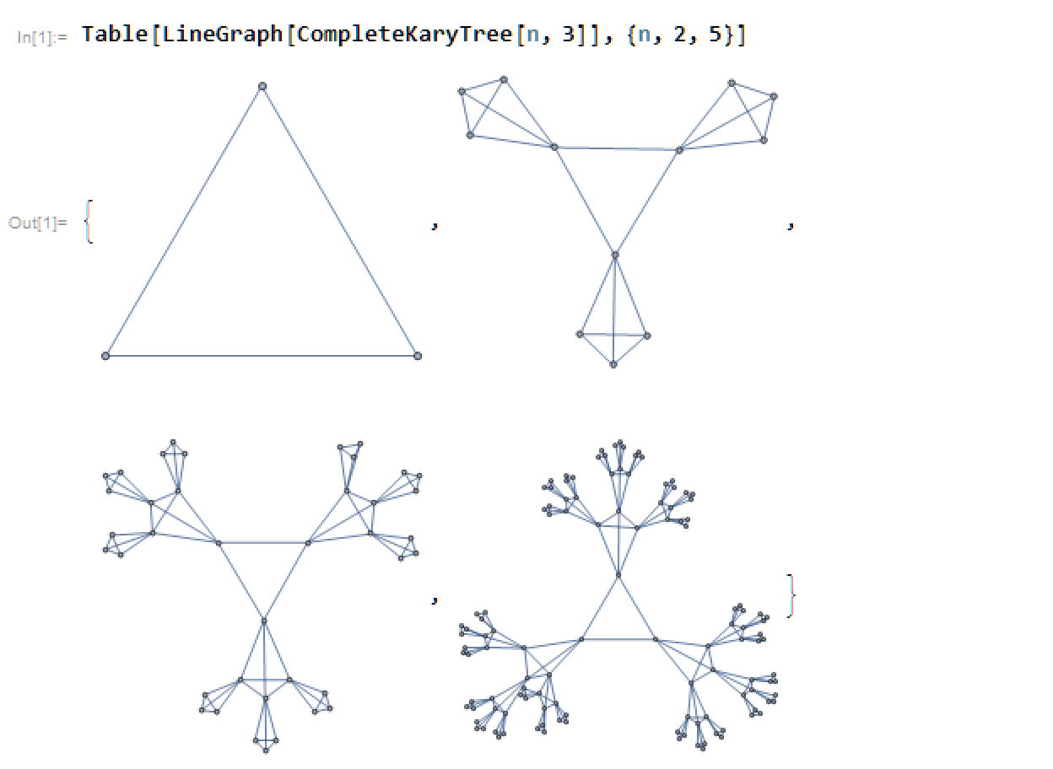
complex things done in one line

Slide 16
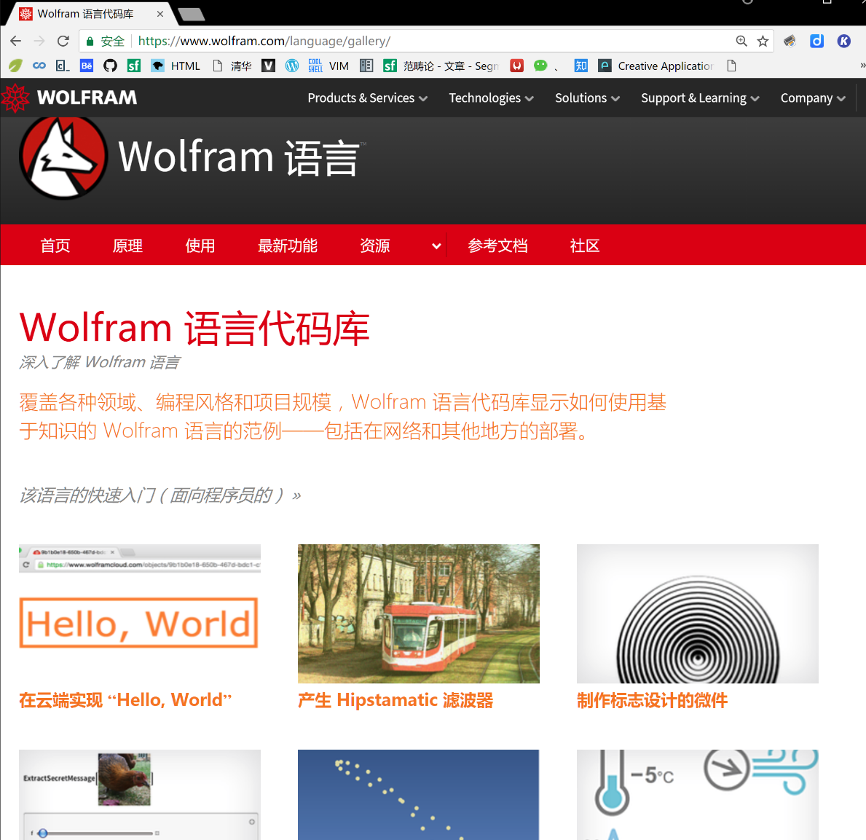
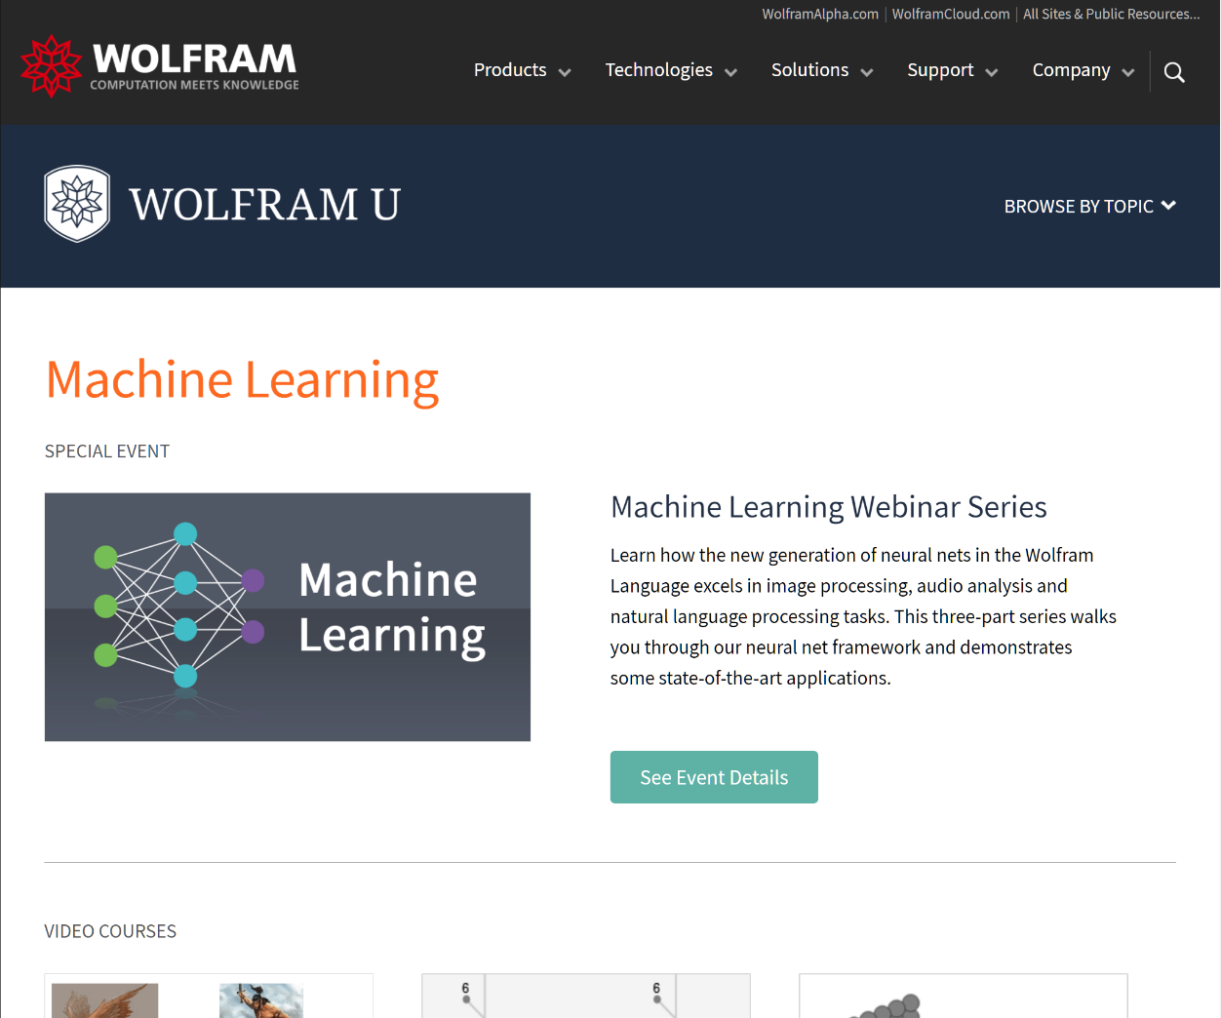
Ample learning stuff

Slide 17
Thank you!

